Slide 1
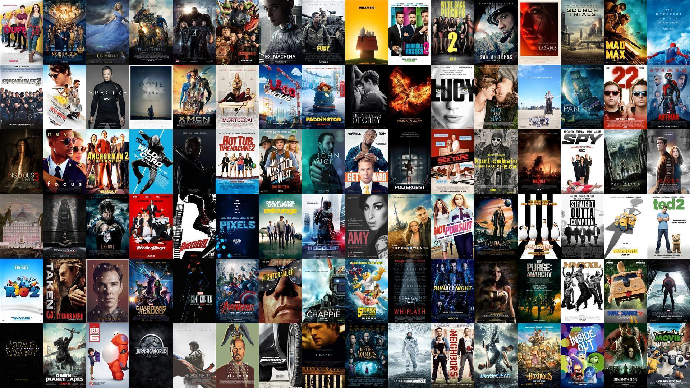

MOVIE GENRE CLASSIFICATION
Deep Learning Final Project
Nicolás Lozada 201727313
Camilo Yate 201630371

Slide 2

Movies Datasets
Two different datasets were provided in order to predict the movie genre: The movie poster and its plot.
The dataset is formed by 11,278 movie posters and plots. The data set has been divided in training and testing set: 7,895 (70%) and 3,383 (30%) movies respectively.
In poster images dataset, each image is stored in two analogous version: full color and grayscale. For classification, purposes, in order to get better predictions, full color version will be used.
For movie plots each movie has a complete description of the plot in natural language format. In this dataset text mining techniques will be applied for getting high performance in classification.
In training set, each poster is classified among 24 different genres (target variable). One movie can belong to several genres.
The proposed classification methodology will be able to predict the genres classification for a movie, given its poster image and plot.

Slide 3
Genre Classification
Genre classification could be divided in three stages: First each dataset will be used for a single classification, then both models will be joined in order to asses genres to each movie.
Dataset
Method
Model Aggregation
PCA
Random Forest
AUROC : 0,586
Average:
The predicted probability for each movie in each genre is the arithmetic mean of each single model
Poster
CNN
AUROC : 0,5
Transfer Learning VGG16
AUROC : 0,6971
Neural Network:
The predicted vectors in each single model is used as input of a new neural network.
Random Forest:
AUROC: 0,7677
Plot Text
Sequential NN
AUROC: 0,8360
LSTM Network
AUROC: 0,51
Models with the best performance are shown in bold

Slide 4
Genre Classification
One final approach is build a neural network taking as input vectors the two data sets at once. The result of the different approaches are the following
Aggregation
Best Performance in Kaggle
In conclusion, the best model will be the average between transfer learning network for images and a sequential network for movie plot. However, the best model in Kaggle was the neural network taking as input vectors the two data sets at once
Best Performance in test subset

Slide 5
Thanks

